Slide 1
ROI Vision
Intelligent Project Analysis
Microsoft Innovation Challenge 2025

Slide 2
Agenda
Overview
Workflow
Main problems
Input data
Project objective
Output data
Architecture
Future Improvements

Slide 3

Overview
Project change management faces recurring challenges, and these factors can compromise the implementation and success of new initiatives. In this presentation, we will introduce an AI-based tool that helps predict risks and mitigate failures, enabling more efficient and effective project management.

Slide 4
Main Problems
Lack of Proper Planning: Implementing complex systems, such as ERPs, without detailed and realistic planning can lead to significant failures.
Inefficient Communication: A lack of clear and continuous communication during the change process can cause confusion and misalignment among teams.
1
3
2
Underestimation of Complexity: Ignoring the depth and scope of necessary changes can result in operational issues and internal resistance.
4
Insufficient Training: Failing to provide adequate training to employees on new systems or processes can undermine the effectiveness of the change.

Slide 5
Project Objective
The ROI Vision tool aims to facilitate strategic decision-making by providing accurate insights and practical recommendations, enabling an objective assessment of investment feasibility and returns.

Slide 6
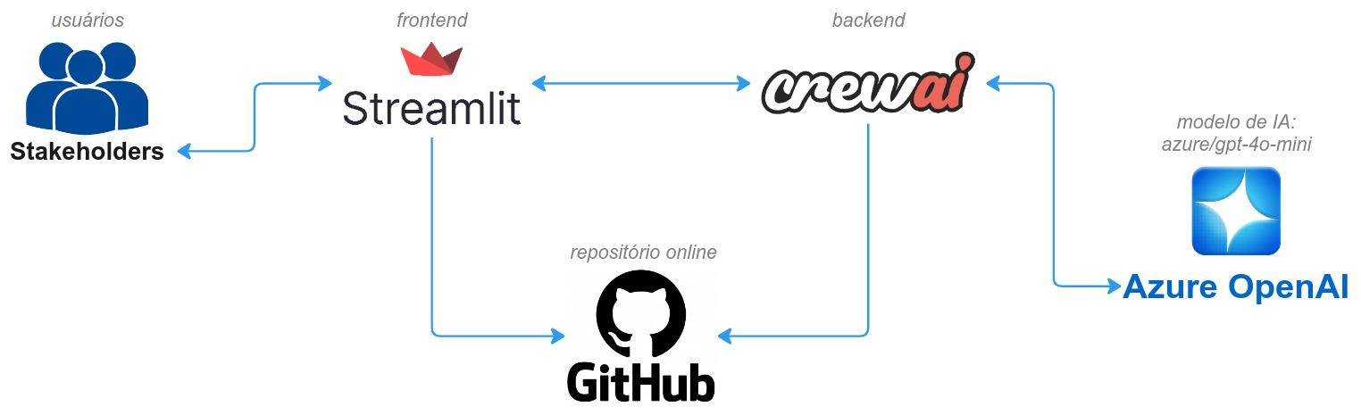
Architecture
The project employs Python 3.12+, Streamlit 1.39.0+, Azure OpenAI, and CrewAI to create an interactive web application for financial KPI analysis. Users input project data via the Streamlit interface, which is processed by CrewAI's autonomous agents to validate data, compute KPIs, and generate insights. Azure OpenAI enhances these insights with advanced natural language processing, delivering comprehensive analyses to the user.

Slide 7
Workflow
​The CrewAI framework orchestrates a team of three specialized AI agents, each fulfilling a distinct role to analyze financial data effectively:​
1. Data Validation Agent
Role: Ensures the accuracy and completeness of input data.​
Function: Checks for missing values, inconsistencies, or anomalies in the provided data, ensuring that subsequent analyses are based on reliable information.​
2. KPI Calculation Agent
Role: Computes key financial performance indicators.​
Function: Processes the validated data to calculate essential metrics such as ROI, NPV, and IRR, providing a quantitative basis for project evaluation.​
3. Insight Generation Agent
Role: Interprets calculated KPIs to offer actionable insights.​
Function: Analyzes the financial metrics to generate recommendations and observations, aiding stakeholders in making informed decisions.​

Slide 8
Input Data
To perform a comprehensive financial analysis, the application requires users to provide the following input data:
Project Name: A unique identifier for the project under evaluation.
Initial Investment: The amount of capital initially invested in the project.
Expected Annual Revenues: Projected yearly income generated by the project.
Expected Annual Expenses: Anticipated yearly operational costs associated with the project.
Discount Rate: The rate used to calculate the present value of future cash flows.
Analysis Period (in years): The time frame over which the financial performance of the project will be assessed.
These inputs enable the application to calculate key financial performance indicators such as Return on Investment (ROI), Net Present Value (NPV), and Internal Rate of Return (IRR), providing valuable insights to inform strategic decision-making.

Slide 9
Output Data
After processing the input data, the application provides the following essential financial results:
Return on Investment (ROI): Measures the profitability of the investment, indicating the return obtained relative to the capital invested.
Net Present Value (NPV): Assesses the project's feasibility by calculating the difference between the present value of future cash flows and the initial investment.
Internal Rate of Return (IRR): Determines the discount rate that makes the NPV equal to zero, aiding in the comparison of projects with different return profiles.
These indicators offer a clear view of the project's financial viability, supporting informed strategic decisions.

Slide 10
Future Improvements
Implement graphical visualizations of KPIs
Create a dashboard with project history
Add attributes such as Sector and Region for detailed analysis
Store data in a database for persistence
Add support for more AI models
Optimize application performance
Use Azure Machine Learning for model training

Slide 11
Team BlueSky
Julio Okuda
Rodrigo Tenório
Luiz Felipe Bom
João Breno

Slide 12
Thank you.

